Slide 1
Simulate gravity wave propagation with MAGIC model
Jintai Li
Final project for
PHYS8715
November 2020

Slide 2
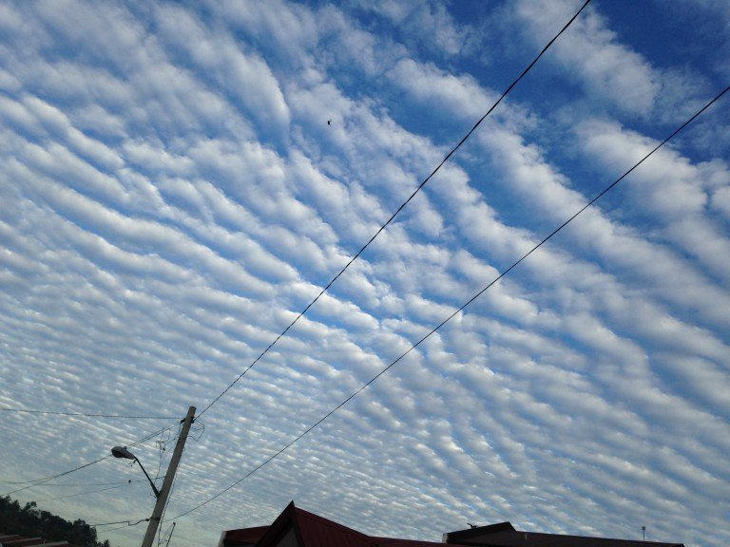
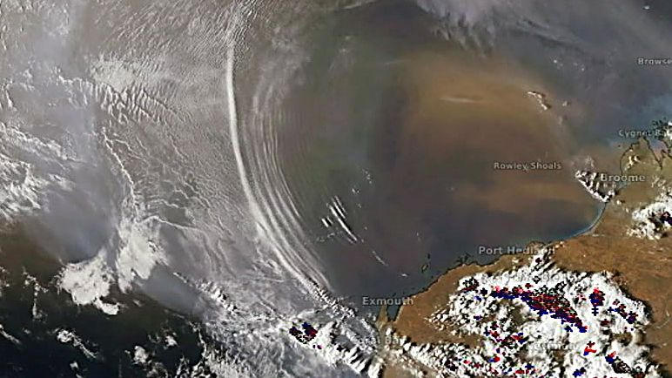
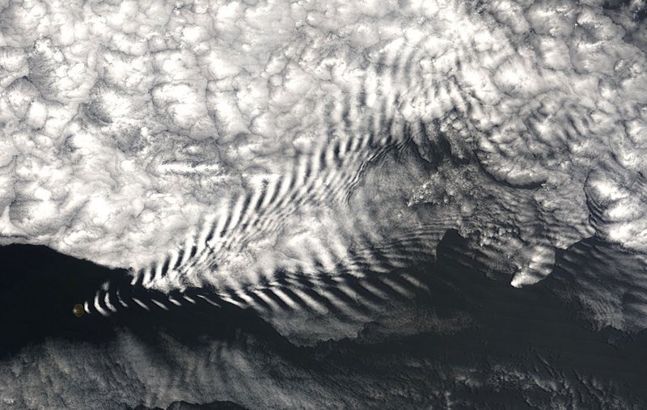
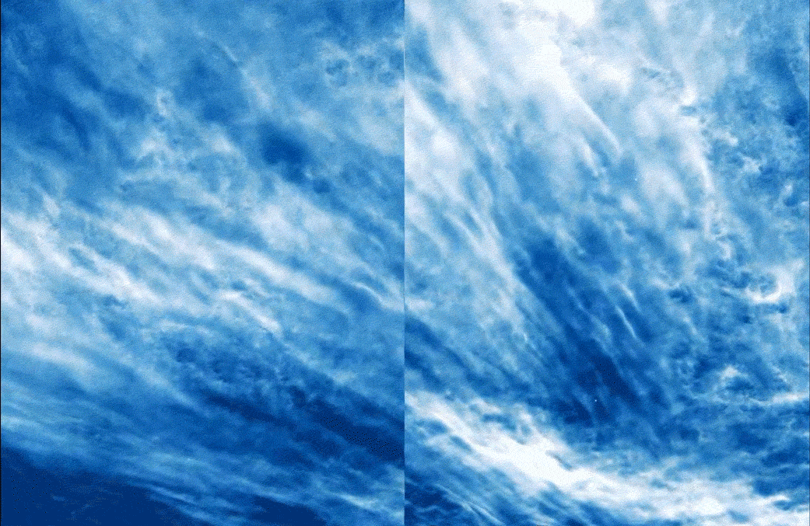
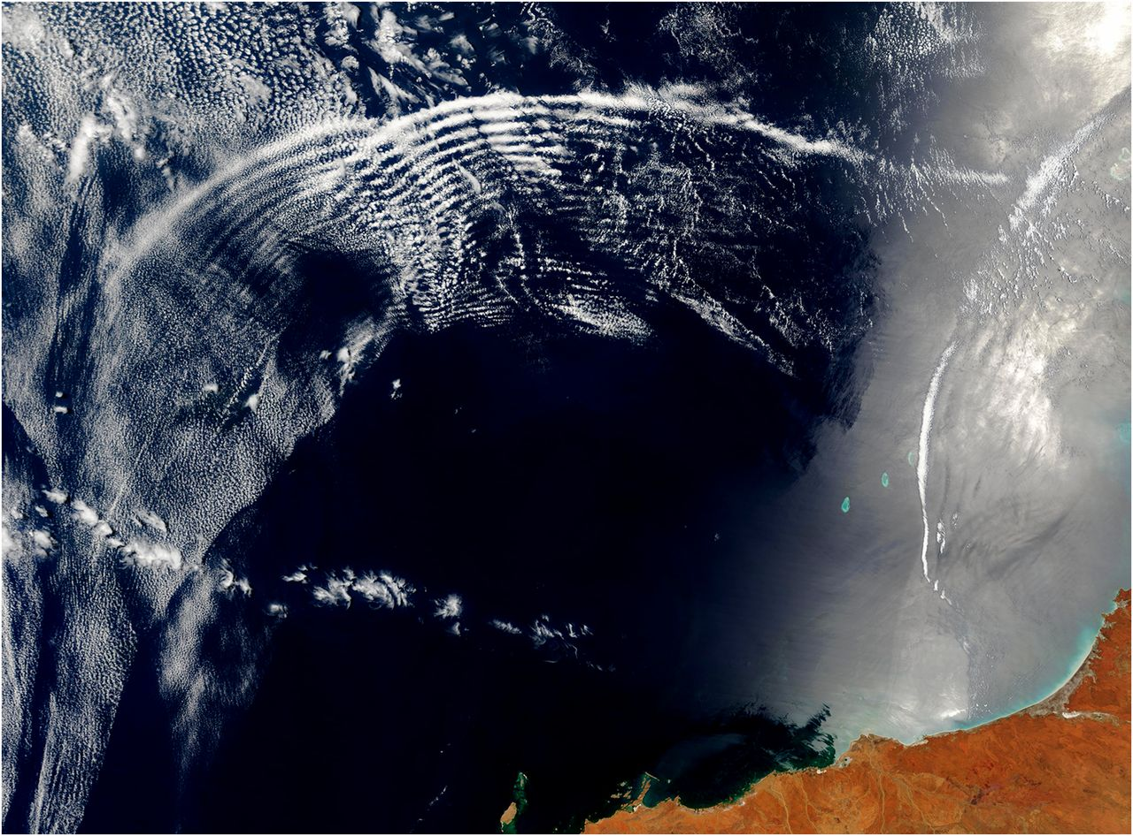
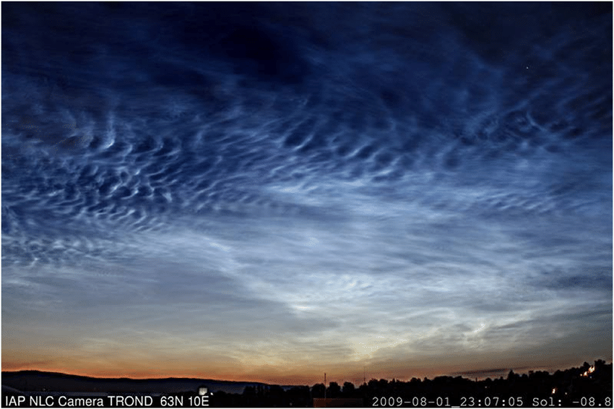

Slide 3
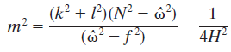
What is gravity wave?
Gravity waves (GWs) are disturbances of the atmosphere that originate in the atmosphere
horizontal wavelengths of a few kilometers to a few thousand kilometers
vertical wavelengths of a few kilometers to tens of kilometers
Frequency of tens of minutes to ~10 hours.
The frequency, horizontal wavenumber and vertical wave number satisfy the following dispersion relation

Slide 4
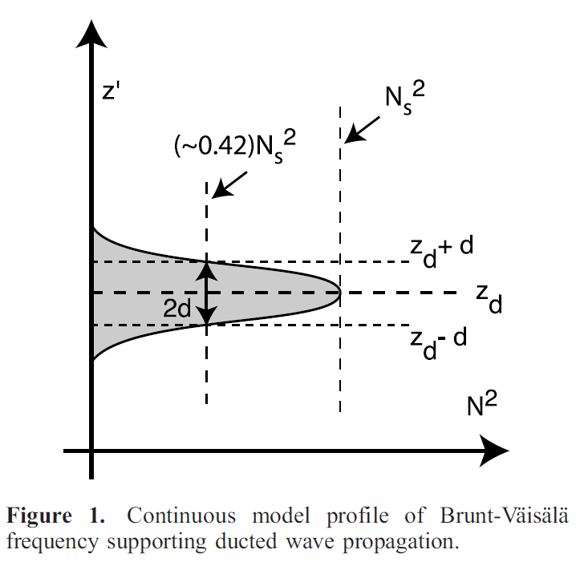
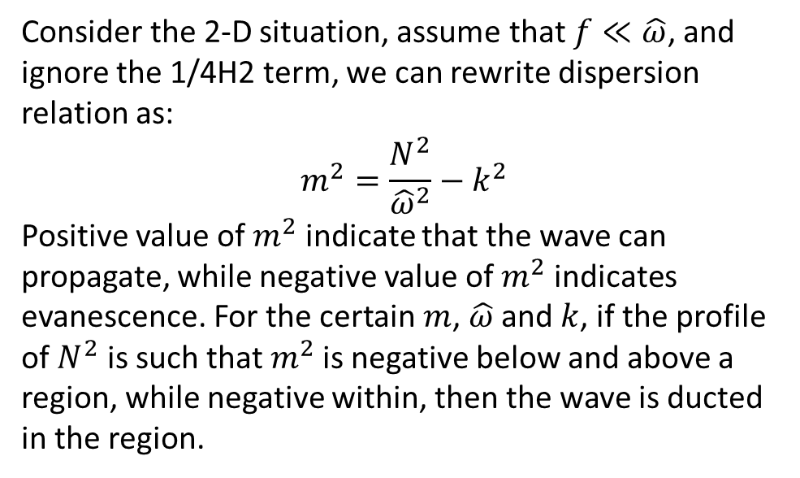
Theory of wave ducting
Consider the 2-D situation, assume that $f≪\hat{ω}$, and ignore the 1/4H2 term, we can rewrite dispersion relation as:
$$m^{2}=\frac{N^{2}}{{\hat{ω}}^{2}}−k^{2}$$
Positive value of $m^{2}$ indicate that the wave can propagate, while negative value of $m^{2}$ indicates evanescence. For the certain $m$, $\hat{ω}$ and $k$, if the profile of $N^{2}$ is such that $m^{2}$is negative below and above a region, while negative within, then the wave is ducted in the region.
Plug this profile into the dispersion relation, we can get
Which can be used to analytically predict the vertical propagation of the wave.
Snively and Pasko, 2008

Slide 5
The model
The MAGIC (Model for Acoustic-Gravity wave Interactions and Coupling) is a 2-D model that solves the non-linear, fully compressible, Euler equations with the inclusion of two separately solved equations describing the effects of molecular and thermal conductivity.

Slide 6
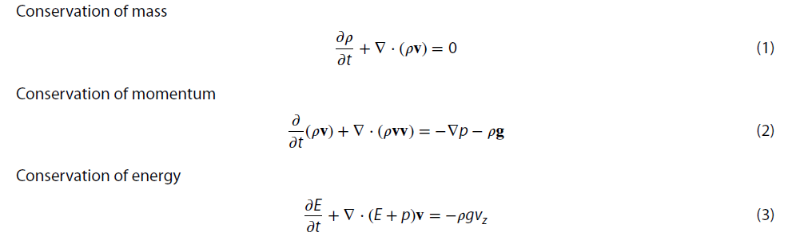
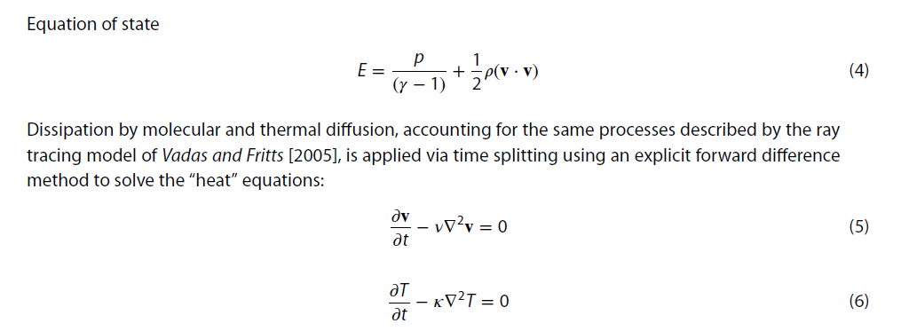

Slide 7
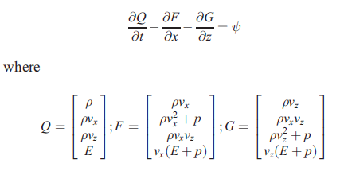
Equations 1-4 can be expressed in a conservation-law form in two dimensions:
Which can be simulated using finite volume scheme.
Boundary conditions:
1), free top
2), bounded bottom where the flux perpendicular to the boundar is zero
3), periodic sides

Slide 8
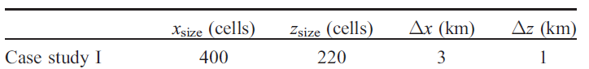
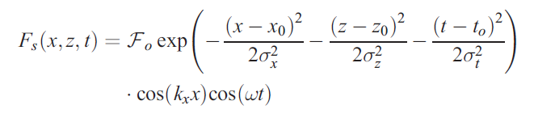
The model setup
Domain parameters
Gravity wave source

Slide 9
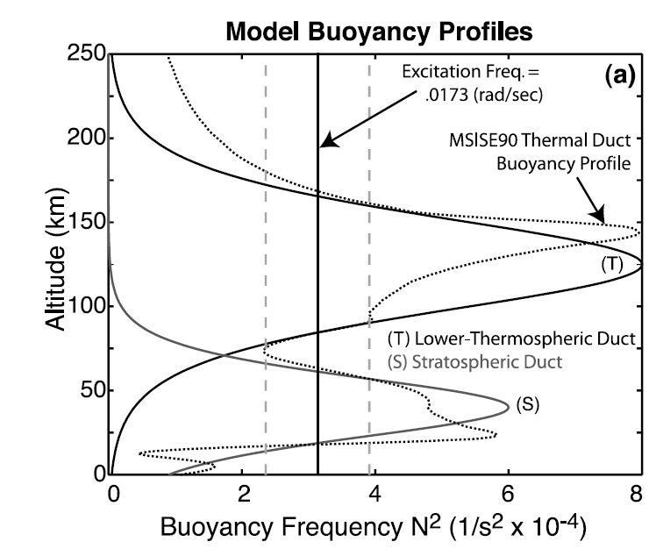
The background atmosphere
The background wind is set to zero to simplify the problem, while the temperature profile is obtained for 15 June 2001, at noon local time, and latitude -11° and longitude 131° (following Snively and Pasko, 2008). The N2 profile is shown as dashed line.
There are two regions where ducting could happen. One near ~40 km, one near ~120 km. The analytical profiles for the two regions of ducting are shown as solid lines.
Snively and Pasko, 2008

Slide 10
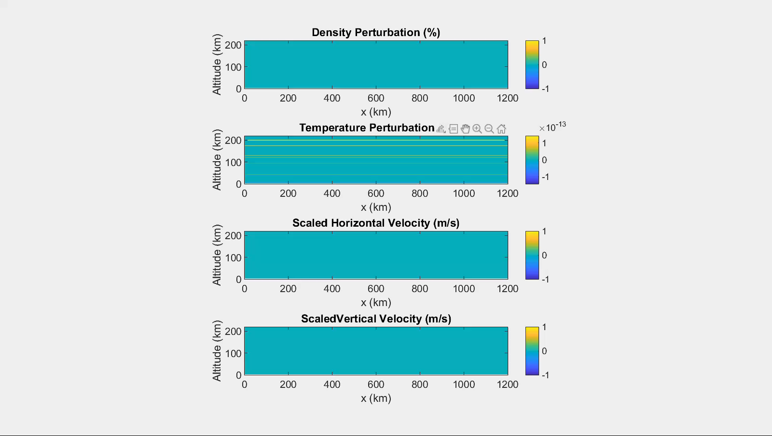
Results

Slide 11
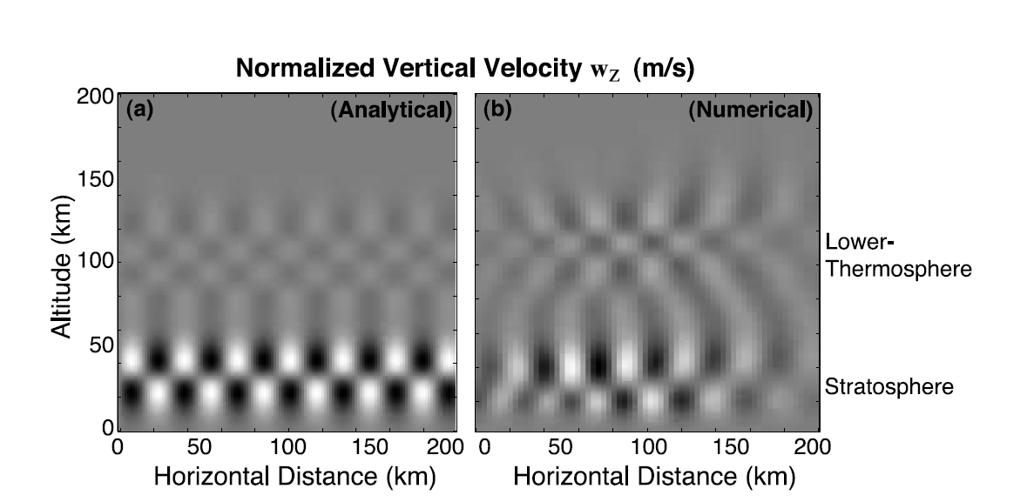
Compare with analytical solution
Normalized vertical velocity

